Slide 1

UNLOCKING INSIGHTS INTO THE GLOBAL AIR TRANSPORTATION NETWORK WITH TABLEAU
TEAM ID: NM2023TMID08174
TEAM LEADER: ANISHA.V
TEAM MEMBERS: ANJA FRANI.A.J
APARNA
ARIYA .P

Slide 2
PROJECT REPORT
1. INTRODUCTION
1.1. OVERVIEW
1.2. PURPOSE
2. PROBLEM DEFINITION & DESIGN THINKING
2.1. EMPATHY MAP
2.2. IDEATION & BRAIN STORMING MAP
RESULT
ADVANTAGES & DISADVANTAGES
APPLICATION
CONCLUTION
FUTURE SCOPE

Slide 3
UNLOCKING INSIGHTS INTO THE GLOBAL AIR TRANSPORTATION NETWORK WITH TABLEAU
INTRODUCTION
1.1. PROJECT DESCRIPTION
Unlocking insights into the global air transportation network is a critical endeavor in today's interconnected world, and Tableau, a powerful data visualization tool, emerges as a beacon of clarity and comprehension. With Tableau's capabilities, we can delve deep into the labyrinthine complexities of air travel, seamlessly transforming vast datasets into actionable intelligence.

Slide 4
1.2. PURPOSE
Unlocking insights into the global air transportation network serves a crucial purpose in addressing the multifaceted challenges and opportunities of our modern world. By gaining a comprehensive understanding of this intricate network, we can enhance safety, security, and operational efficiency, ultimately improving the travel experience for passengers.

Slide 5
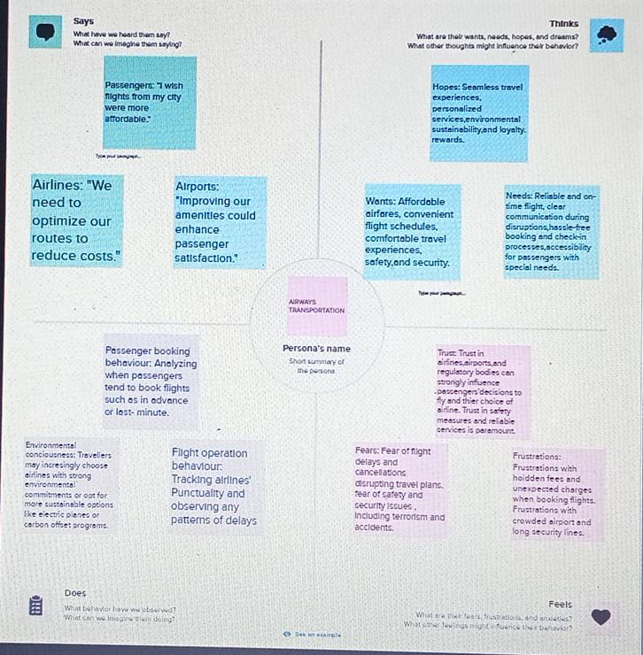
2. PROBLEM DEFINITION & DESIGN THINKING
2.1. EMPATHY MAP

Slide 6
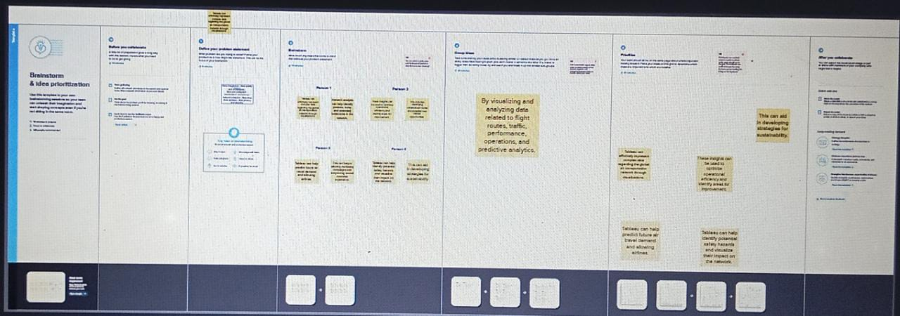
2.2. IDEATION & BRAINSTORMING MAP

Slide 7
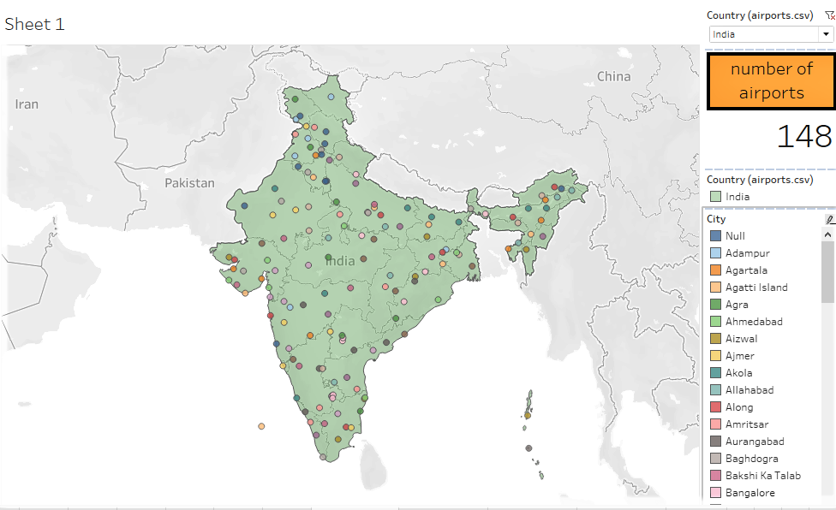
3. RESULT
DASHBOARD 1

Slide 8
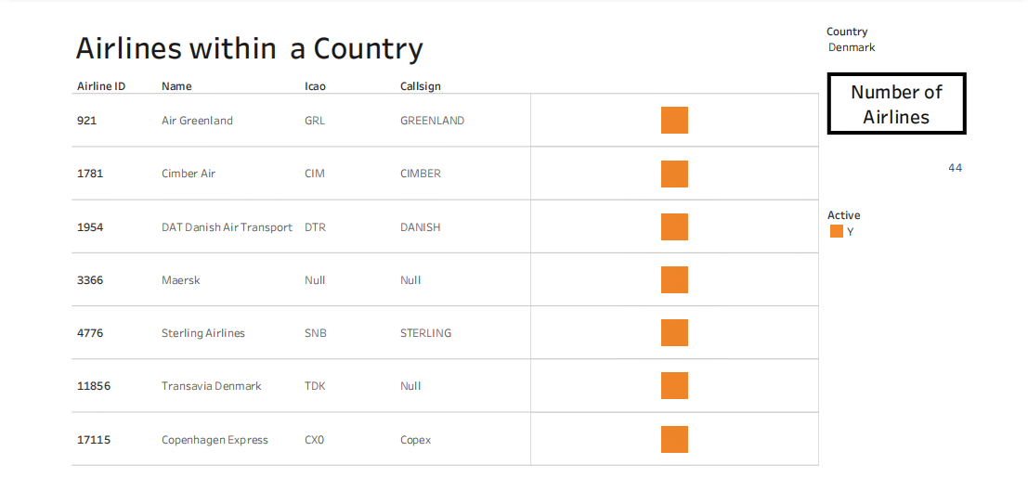
DASHBOARD 2

Slide 9
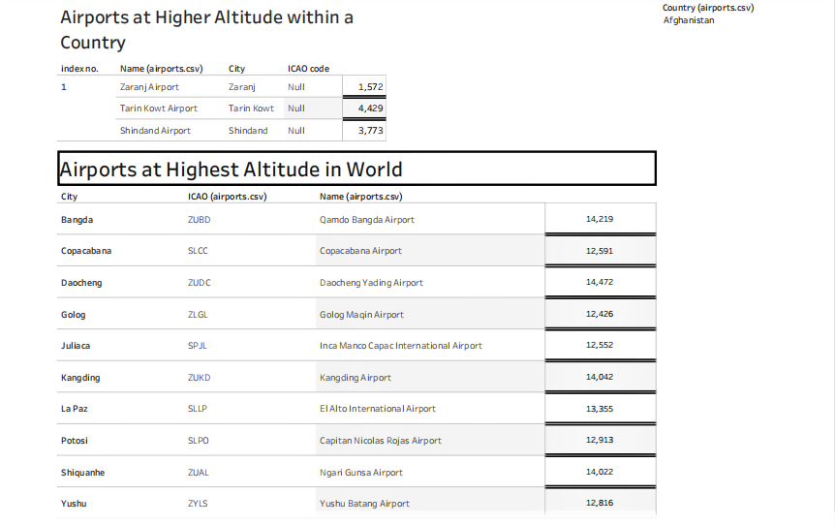
DASHBOARD 3

Slide 10
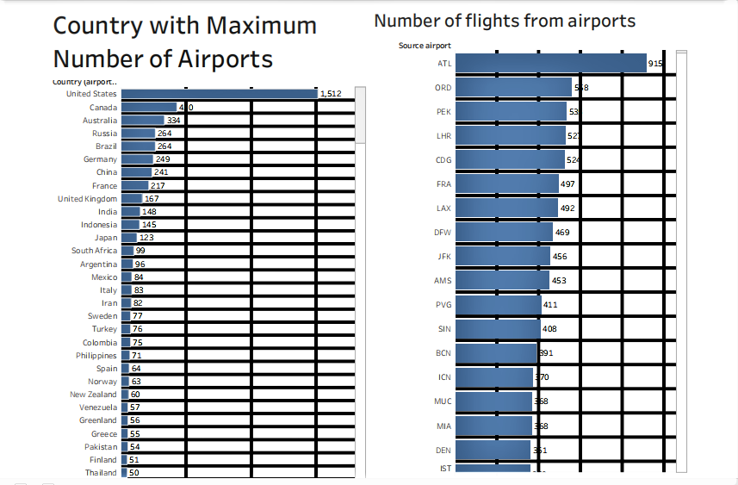
DASHBOARD 4

Slide 11
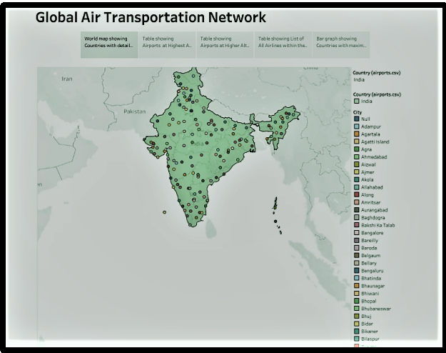
STORY

Slide 12
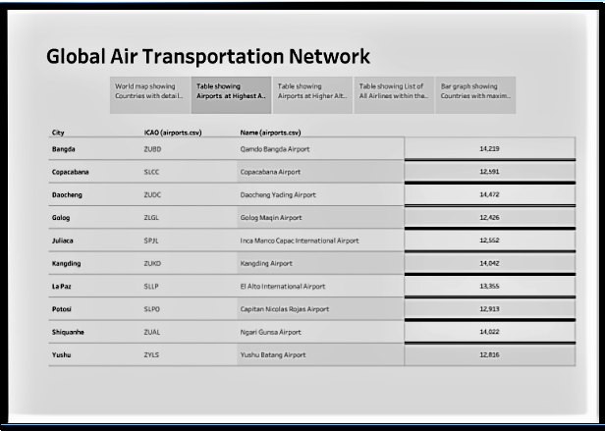

Slide 13
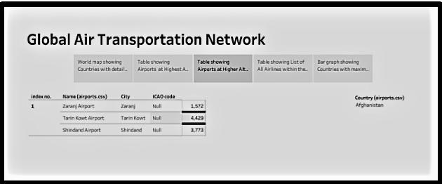

Slide 14
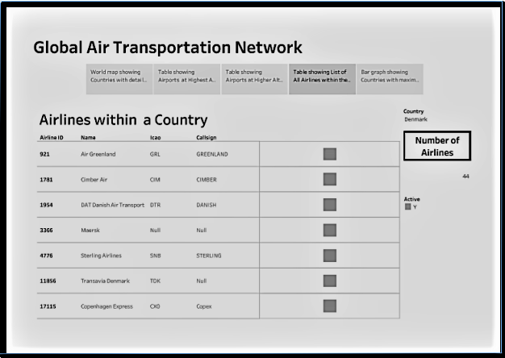

Slide 15
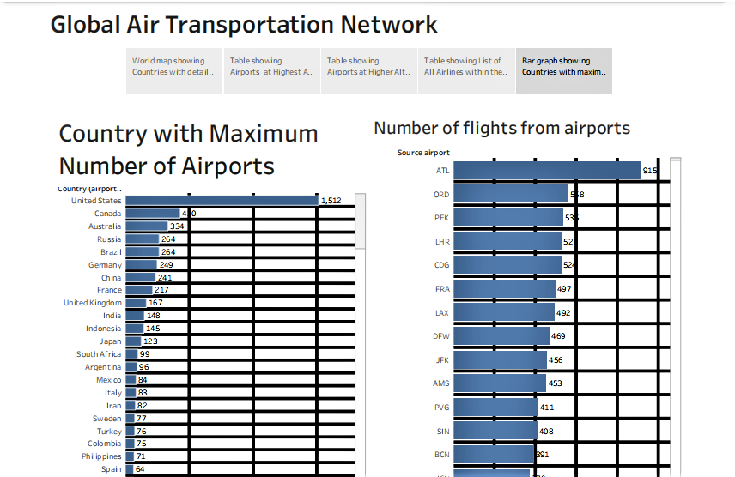

Slide 16
4. ADVANTAGES & DISADVANTAGES
ADVANTAGES
Enhanced Safety: Deep insights can identify potential safety risks, enabling proactive measures and improved overall safety standards in the aviation industry.
Operational Efficiency: Understanding traffic patterns, demand fluctuations, and delays allows airlines to optimize schedules, reduce costs, and enhance on-time performance.

Slide 17
DISADVANTAGES
Privacy Concerns: Extensive data collection and analysis can raise concerns about passenger privacy and the potential for data misuse, leading to ethical and regulatory challenges.
Data Security Risks: Storing and transmitting sensitive flight and passenger information for analysis poses cybersecurity risks, with the potential for data breaches and unauthorized access.

Slide 18
5. APPLICATION
The application of unlocking insights into the global air transportation network is paramount for addressing a range of critical challenges and opportunities.
This includes optimizing flight routes and schedules to enhance operational efficiency and reduce environmental impact, improving safety and security protocols to ensure the well-being of passengers and the industry workforce, and enhancing the passenger experience by tailoring services and amenities.
Moreover, these insights have broader implications for economic growth and global connectivity, driving tourism, trade, and job creation.

Slide 19
6. CONCLUSION
In conclusion, the endeavor to unlock insights into the global air transportation network is a vital and multifaceted pursuit. It serves not only as a catalyst for improving the safety, efficiency, and sustainability of the aviation industry but also as a powerful tool for enhancing the passenger experience and bolstering economic growth worldwide. By harnessing the potential of data-driven analysis, we not only unravel the complexities of global air transportation but also pave the way for a more interconnected, secure, and environmentally responsible future, where the skies are not just pathways for travel but also a canvas for innovation and progress.

Slide 20
7. FUTURE SCOPE
The future scope for unlocking insights into the global air transportation network is exceptionally promising, as advances in technology and data analytics continue to evolve. With the increasing integration of artificial intelligence and machine learning, we can anticipate more accurate and real-time predictions, further enhancing operational efficiency, safety, and environmental sustainability. The advent of smart airports, connected aircraft, and improved communication systems will provide even more comprehensive data, enabling the aviation industry to make faster and more informed decisions.

